Slide 1



Dineout
Live Product Challenge 105
Monetization features for Dineout
Virendra Kumar Verma
Linkedin
Gmail

Slide 2







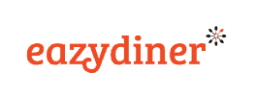
Overview
User Personas
Features
Prioritization
Success Metric
GTM
Problem Statement -
You’ve joined Dineout as Director of Product.
For years, you have been known for table reservations and providing offers on bills for users. At present, the commission charged from users and restaurants as well as your subscriptions form the core of your revenues. With your recent acquisition by Swiggy, you feel you can leverage the competencies and the brand-value of Swiggy and venture into more streams and verticals that can generate revenue for you.
About Dineout –
Dineout is India’s largest dining out and restaurant tech solutions platform in B2B and B2C, processing more than 100M diners and $800M worth of transactions for its partner restaurants across its network of 50,000 restaurants in 20 cities, providing a collective saving of more than $100M on restaurant bills annually. Recently Swiggy acquired dineout in an all-equity deal at $200M.
Key data points -
Competitors -
Total monthly visit
2.0 M
Bounce rate
38.20%
Annual active users
5.0 M
Revenue
INR 1000 Cr
Playstore rating
4.7
Playstore downloads
5M+

Slide 3


Overview
User Personas
Features
Prioritization
Success Metric
GTM
Sharad
29
Delhi
Student
Vikrant
42
Bangalore
Businessmen
Goal -
Wants to throw a surprise party for his wife on their 2nd anniversary.
Wants to book a banquet hall.
Wants to compare between different banquet hall.
Wants to decorate arrange food for the party.
Pain Points -
No webpage/platform available where she can compare all the venues.
Difficult to visit and reserve the banquet to due to work pressure.
Goal -
Travel frequently to different cities.
Stays is 4 star or 5 star and wants to compare the hotel before booking.
Wants to eat his favorite dish.
Wants food after reaching the hotel.
Pain Points –
Difficult to compare and reserve 4/5-star hotels
He needs to order the food after reached at hotel
Foods take time to deliver at hotel room
Couldn’t find his special or fav dishes in the menu.

Slide 4
Overview
User Personas
Features
Prioritization
Success Metric
GTM
Feature 1: Hotel Booking and Order Food
User can book the hotels (including luxury/ 4-star/ 5-star hotels)
They can compare multiple hotels before booking.
They can opt for the food if offered by any hotel. In this case they will get an extra discount.
Users need to provide an estimate time of arrival. Based on that food will be delivered to room as soon as users check in to the room.
They can get many offers/deals on the booking.
They can pay using dineout pay and they can use PromoCash while paying.

Slide 5
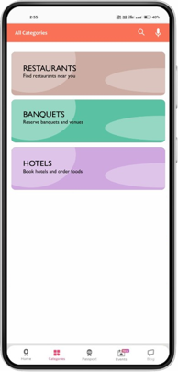
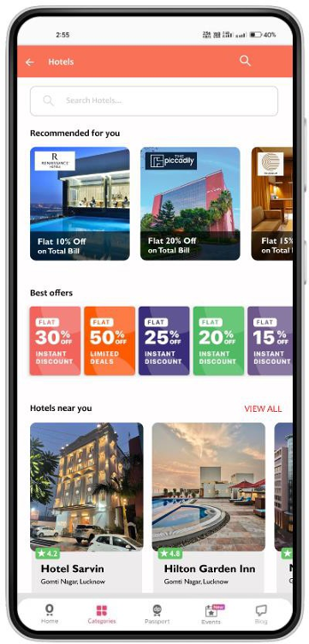
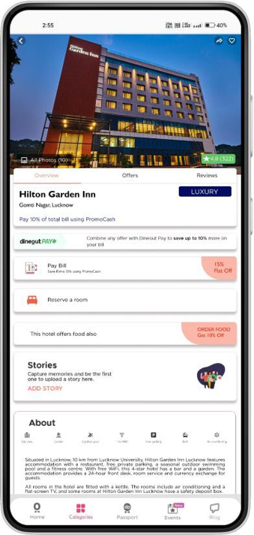
Overview
User Personas
Features
Prioritization
Success Metric
GTM
Recommended hotels as per user hotels booking history
User can book the hotel using this tab
Deals on hotel bookings
User can order food based on estimated arrival time the food will be delivered to room, if user opt for this, they will get extra discount

Slide 6
Overview
User Personas
Features
Prioritization
Success Metric
GTM
Feature 2: Banquets and Venues
Users can book the banquets and venues for the even.
They can compare multiple banquets before booking.
They can opt for the decoration service-in this case they will get extra discounts.
They can get many offers/deals on the booking.
They can pay using dineout pay and they can use PromoCash while paying.
Birthday celebrations​
Anniversaries​
Engagement​
Kitty Parties​
Etc.​

Slide 7
Overview
User Personas
Features
Prioritization
Success Metric
GTM
Time Limit
People Limit
No overuse of intoxicated stuffs
Terms and conditions
Etc.

Slide 8
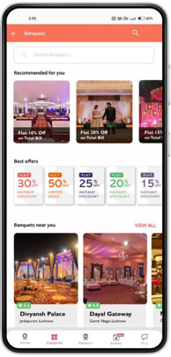
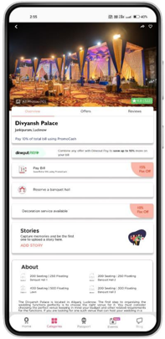
Overview
User Personas
Features
Prioritization
Success Metric
GTM
Recommended hotels as per user banquets booking history
Deals on banquet bookings
User can book the hotel using this tab
User can opt for decoration service, where our partner will decorate for you. If user for this, they will get extra discount

Slide 9
Overview
User Personas
Features
Prioritization
Success Metric
GTM
RICE Framework
 | Reach (Out of 10) | Impact (Out of 5) | Confidence (Out of 100%) | Effort (Out of 10) | RICE Score | Prioritization
Hotel Booking | 8.5 | 4 | 85% | 9 | 321.12 | 2nd
Banquets | 9 | 4.5 | 80% | 9 | 360 | 1st

Slide 10
Overview
User Personas
Features
Prioritization
Success Metric
GTM
Features | Add Recipe | Hotel booking and Order food | Occasion booking
Happiness | DAU & MAU Net promoter score Number of 5-star reviews for Add Recipe feature | DAU & MAU Net promoter score Number of 5-star reviews for Add Recipe feature | DAU & MAU Net promoter score Number of 5-star reviews for Add Recipe feature
Engagement | # of customers adding stories from Dineout Add Story feature in this page Average session length in this page | # of customers adding stories from Dineout Add Story feature in this page Average session length in this page | # of customers adding stories from Dineout Add Story feature in this page Average session length in this page
Adoption | # of new and repeat customers using the Add Recipe service % new visitors using Recipe service | # of new and repeat customers using the Hotel Booking and Order food service % new visitors using hotel booking | # of new and repeat customers using the decoration service % new visitors using Banquets or Party Space.
Retention | % of repeat customers using Add Recipe service Stickiness Ratio | % of repeat customers using Add Recipe service Stickiness Ratio | % of repeat customers using Booking Banquet or Party Space service & using decoration Stickiness Ratio

Slide 11
Overview
User Personas
Features
Prioritization
Success Metric
GTM
Market Research & Analysis
Feature Development
Beta Launch
Feedback
Final Release
Once all the pain points and JBTD are resolved, features are developed, and QAs are completed it can be launched in the market for all
Agile methodology will be followed for feature releases.
Features improvement will be communicated through push notification and app store update information.
Identify the user segments, understand the pain points of each user segment.
Conduct surveys to identify the potential features.
Conduct competitor analysis.
Prioritize the features identified from survey and analysis using RICE matrix, design and develop the features.
Lay out acceptance criteria, testing scenarios for all user journeys.
Validation: QA and UAT sign off.
The feature will be rolled out in Tier-1 cities.
Collect performance data and user feedback to improve UX.
Validation: Observable improvement in KPIs.
Collect user feedback and improve the beta version.
Track the success metrics and conduct interviews with customer and focus to understand the pain points in the versions and jobs-to-be-done
Validation: less than 30% unhappy users.

Slide 12
Thank You

